Slide 1
On The Horizon
Google slides is the preferred way to view this:
https://docs.google.com/presentation/d/12WRXuZktEtViwBWxFwm8OHpwpgoOpAF01859o0jGkiw/
Exploring how Rocket Pool can accelerate to maturity
Samus Valdorff

Slide 2
Challenges and Goals

Slide 3
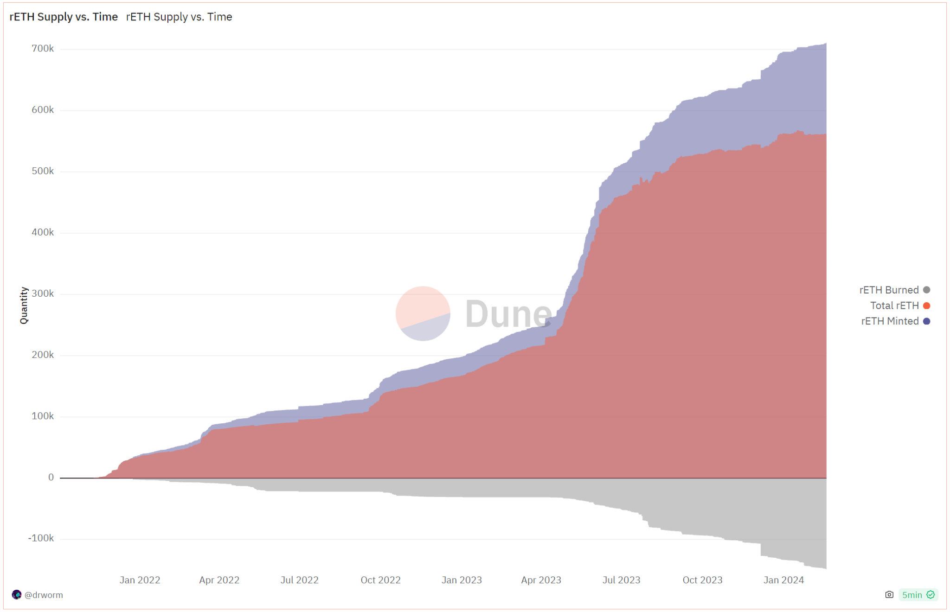
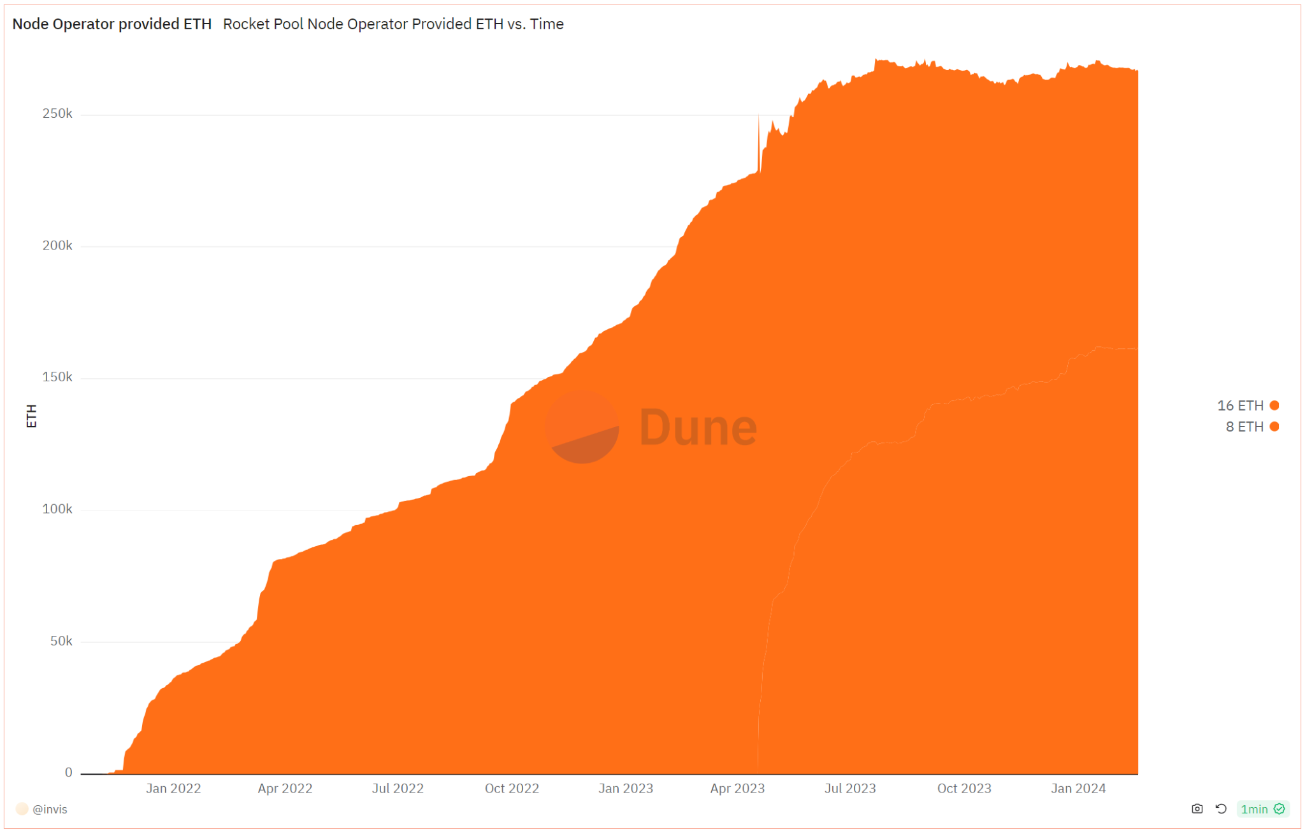
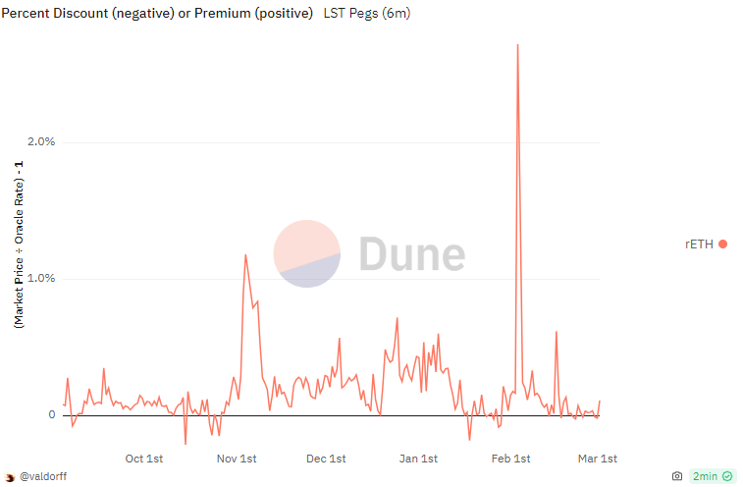
Current challenges
We’re not able to keep up with rETH demand
We’re struggling to attract new NO (Node Operator) ETH
Sources: https://dune.com/rp_community/lst-comparison, https://dune.com/drworm/rocketpool, https://dune.com/invis/rp-neth

Slide 4
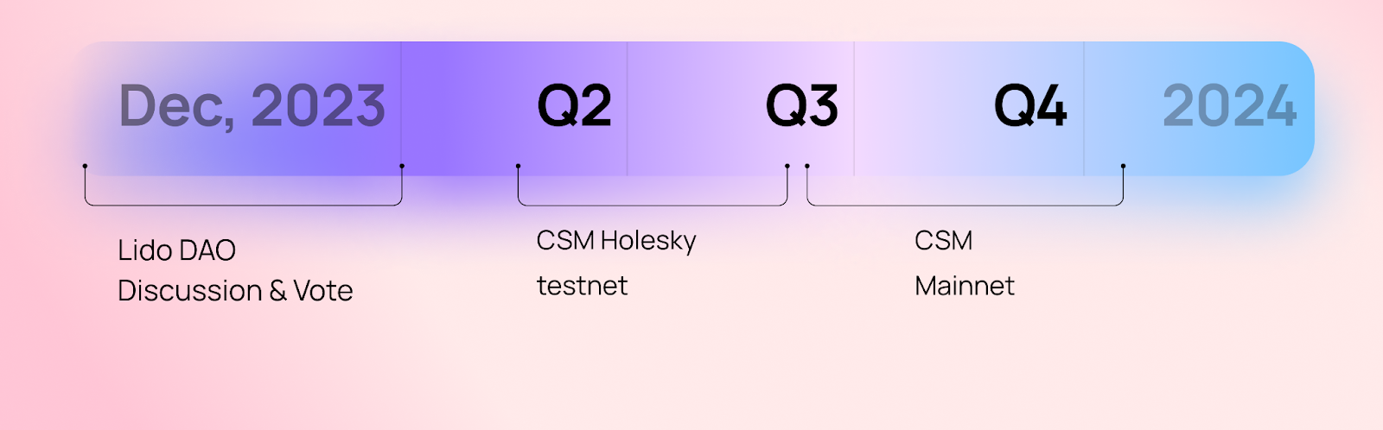
We’ll need to compete for Node Operators
Sources: https://research.lido.fi/t/bond-and-staking-fee-napkin-math/5999

Slide 5
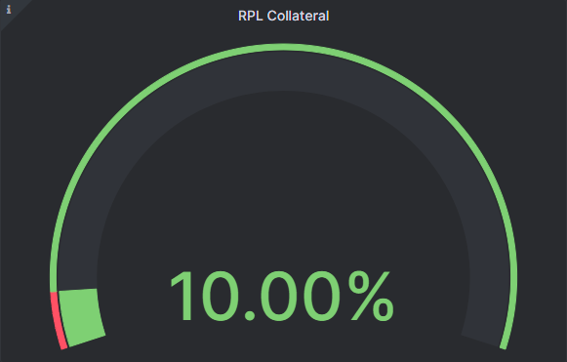
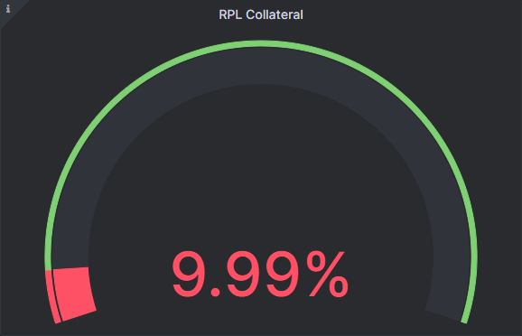
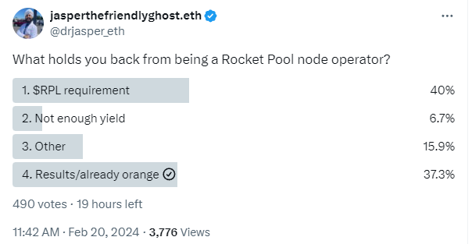
What’s causing our challenges?
RPL rewards drop to zero below 10% Borrowed ETH
Current RPL value capture is modeled on folks topping off
Running minipools requires RPL exposure/speculation
The rewards aren’t attractive enough
Compare with rETH + defi
Compare effort vs rETH
Compare taxes vs rETH
Compare ROI vs incoming Lido CSM
Current LEB8s are ~1.09x solo apy (assuming flat RPL/ETH)
Lido CSM is expected to be ~1.5x solo apy
Gas costs per minipool
63.9%
10.7%
25.4%

Slide 6
Goals of a rework
Enable Node Operation without RPL
Retain or improve RPL value
Enable more capital efficiency
Enable the protocol to attract rETHers
Enable the protocol to adapt if/as needed in the future

Slide 7
Core Vision

Slide 8
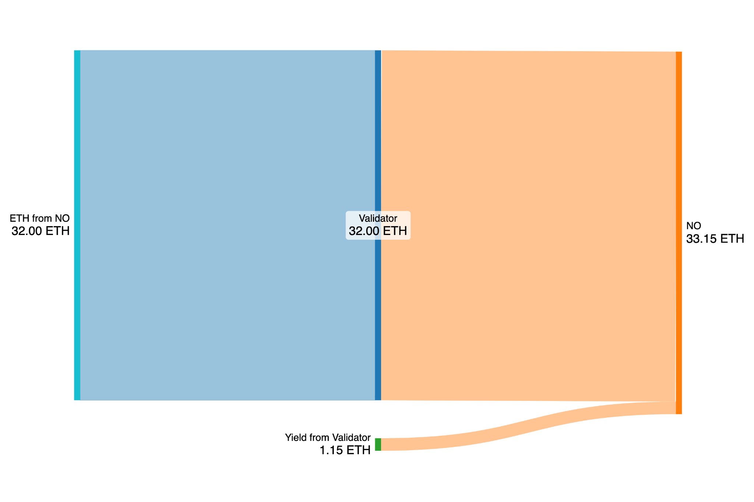
Solo Staker
Earning Yield example:
One year of yield is shown
APR is 3.6%
Creating a Validator:
NO puts a 32 ETH bond at stake
NO earns yield for validation services

Slide 9
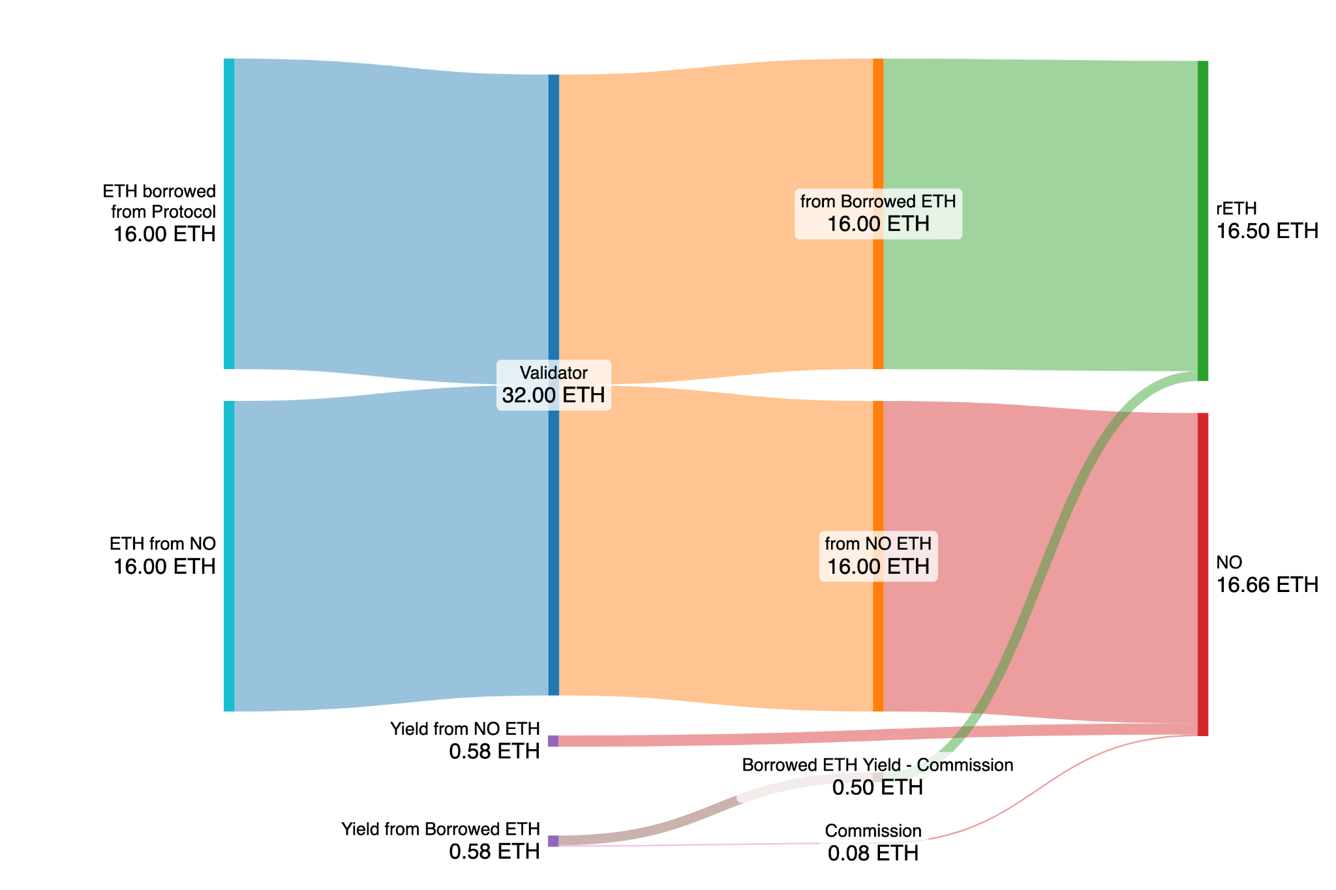
Rocket Pool Validator - 16ETH NO Bond
ETH Yield:
NO earns solo APR yield for their own ETH bond
NO takes 14% commission on yield from Borrowed ETH
1.14x more than Solo Staking
Creating a Validator:
NO borrows 16 ETH from Rocket Pool
NO puts up a 16 ETH bond
NO is required to stake ≥1.6 ETH worth of RPL (≥10% Borrowed ETH value; ≥9.1% RPL exposure)

Slide 10
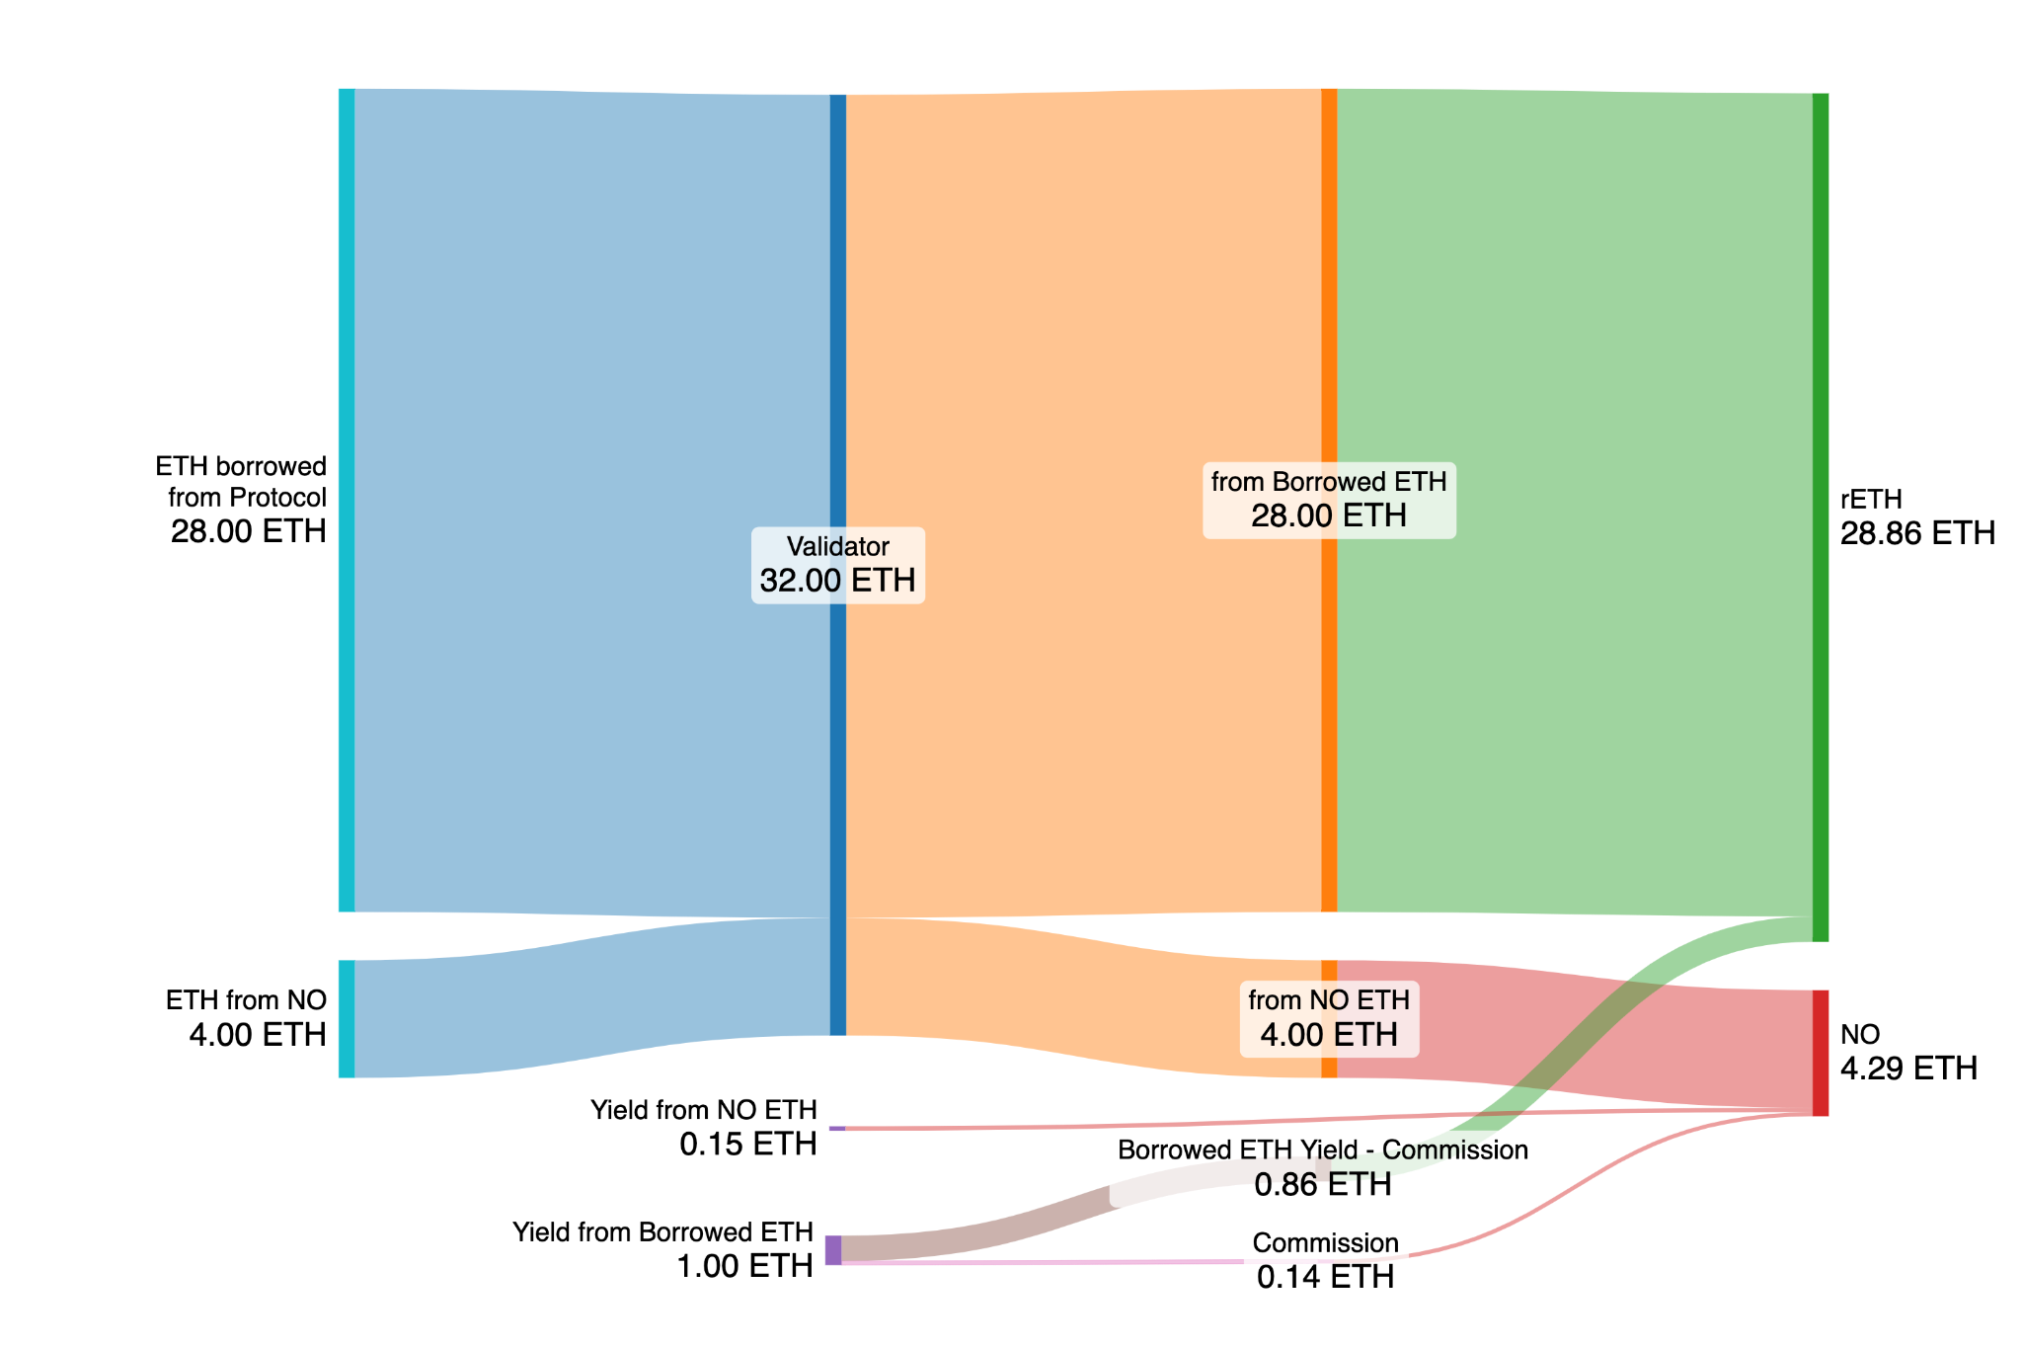
Rocket Pool Validator - 4 ETH NO Bond
ETH Yield:
NO earns solo APR yield for their own ETH bond
NO takes 14% commission on yield from Borrowed ETH
1.98x more than Solo Staking
Creating a Validator:
NO borrows 28 ETH from Rocket Pool
NO puts up a 4 ETH bond
NO is required to stake ≥2.8ETH worth of RPL (≥10% Borrowed ETH value; ≥41.2% RPL exposure)
Let’s simplify things and just focus on revenue from Borrowed ETH

Slide 11
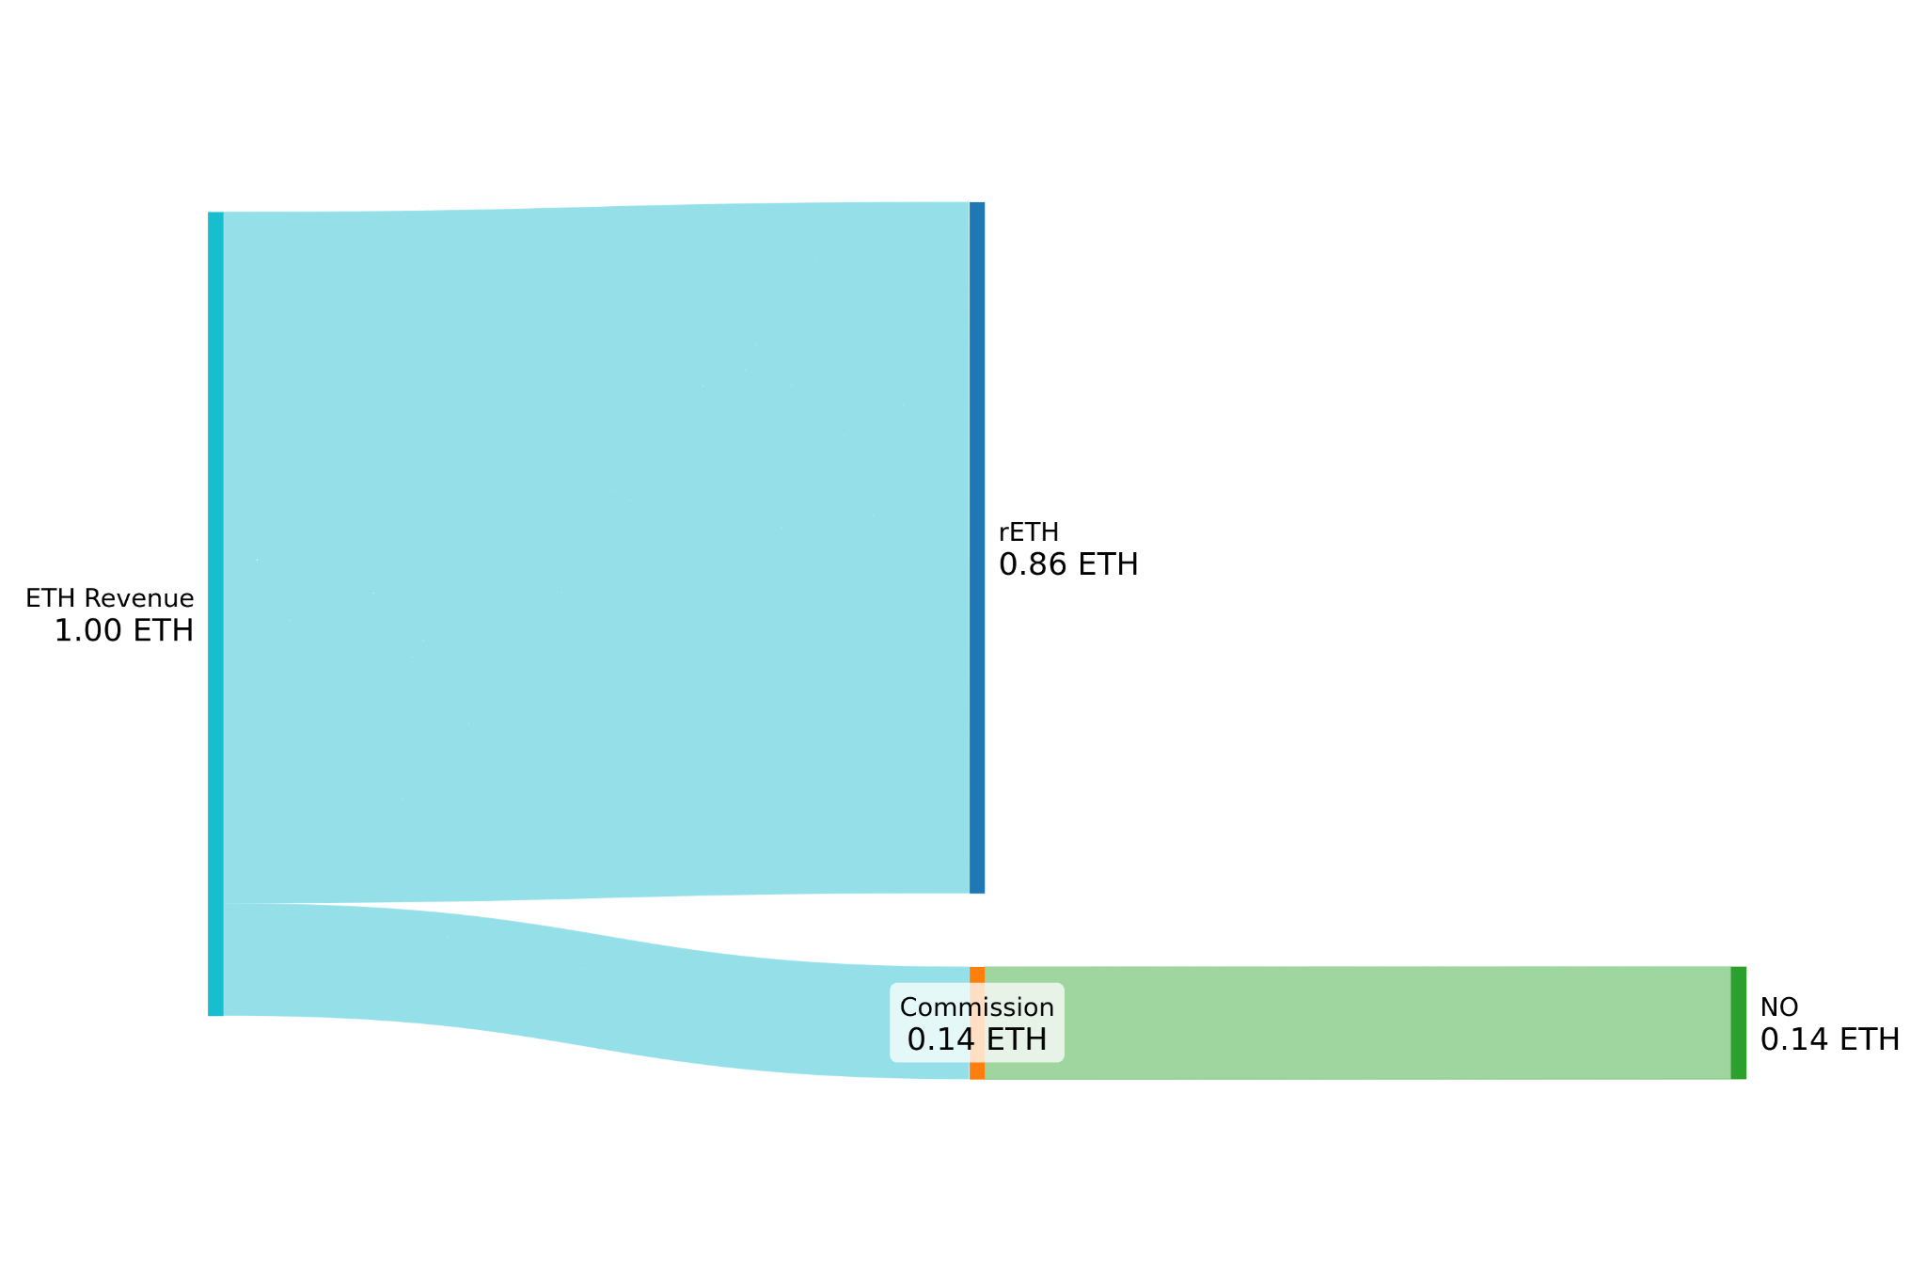
Simplified
NO A | 4 ETH | 280 RPL
Here is the same flow, just focusing on revenue from Borrowed ETH:
Assume prices below: ETH = $3k, RPL =$30
280 RPL = 2.8 ETH
2.8ETH / 28 ETH = 10%
86%
14%

Slide 12
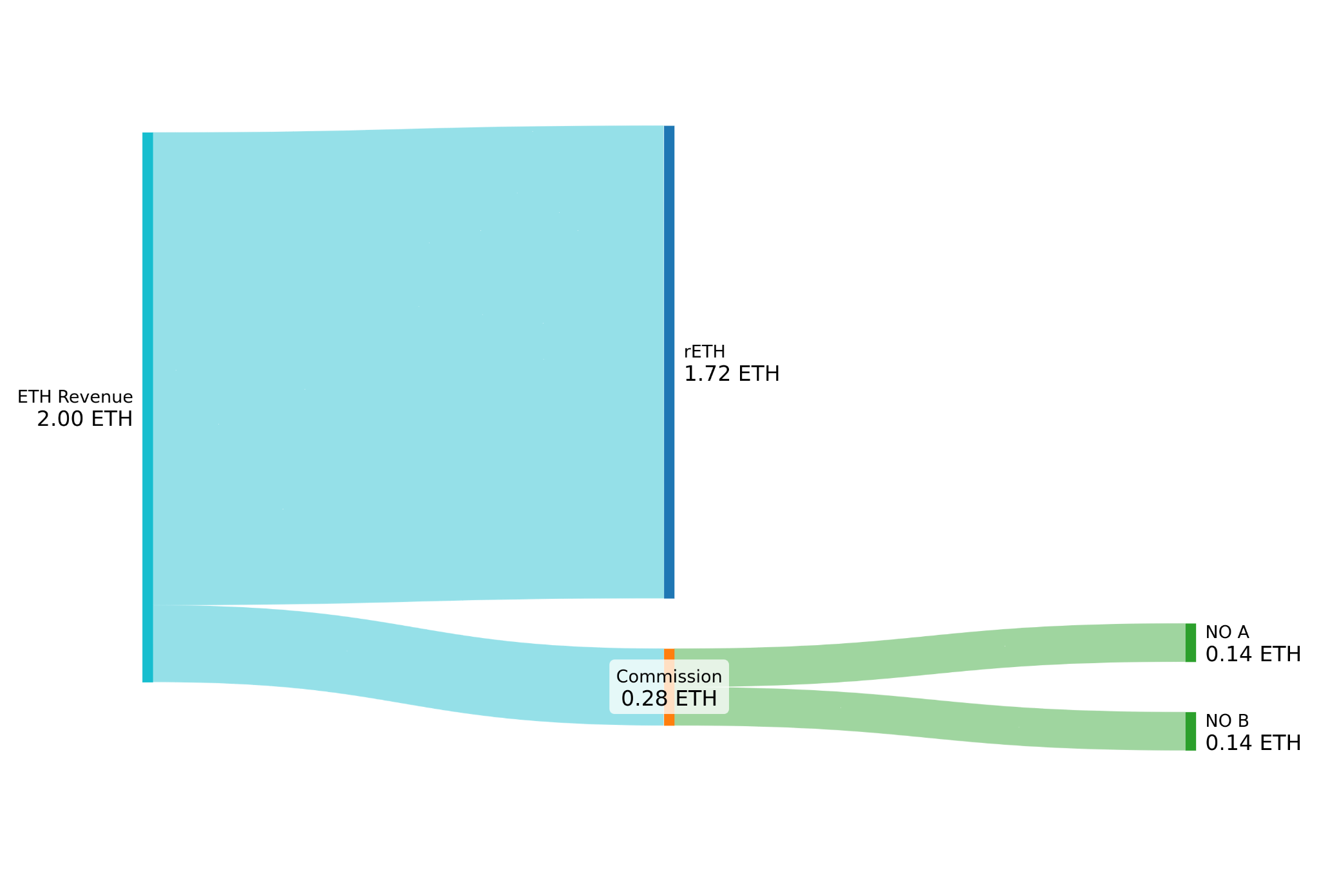
Current
NO A | 4 ETH | 280 RPL
NO B | 4 ETH | 560 RPL
All new validators charge a fixed 14% commission on borrowed ETH revenue
86%
14%

Slide 13
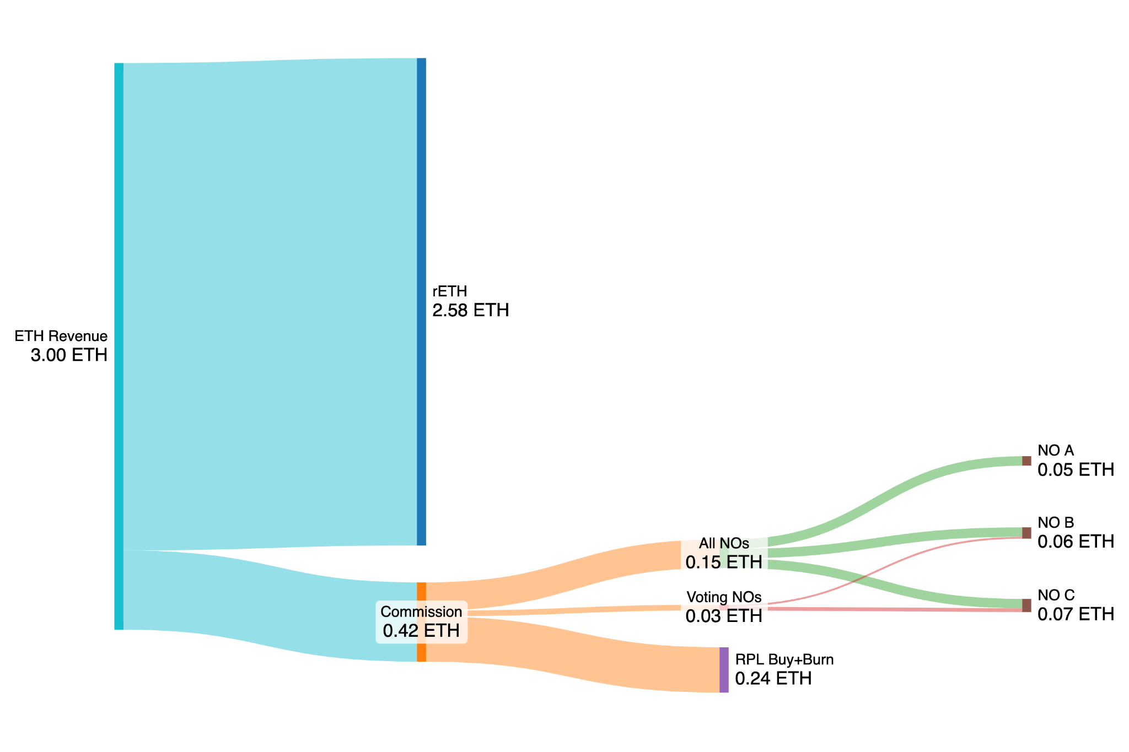
Proposal
NO A | 4 ETH | 0 RPL
NO B | 4 ETH | 300 RPL
NO C | 4 ETH | 1000 RPL
A share of the total protocol revenue is used to buy and burn RPL
A share of the total protocol revenue goes to Voting NOs
All NOs earn commission on borrowed ETH, in the same way as before
Note that NO C earns twice as much from “Voting NOs” compared to NO B
86%
Effective Voting RPL is capped at 150% bonded ETH;
NO C is capped at 600 RPL
NO A
No exposure to RPL
1.35x more ETH yield than solo
5%
14%
1%
8%

Slide 14
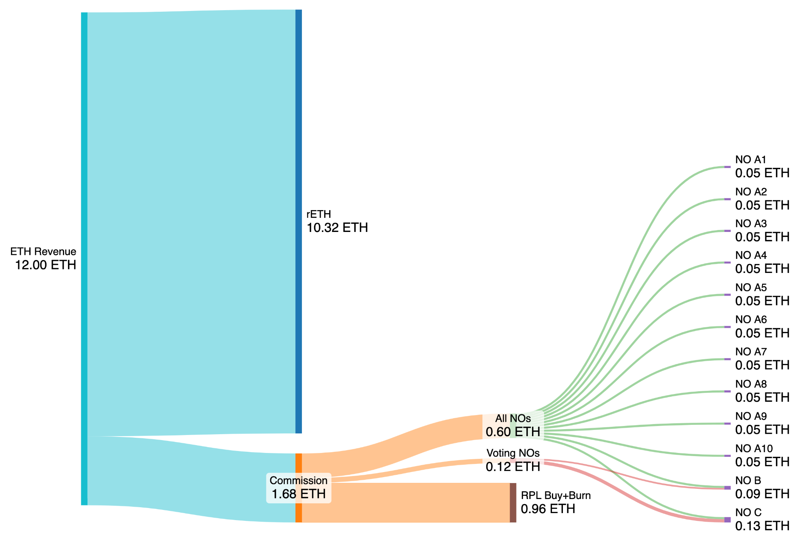
What if everyone likes ETH-only?
10 * NO A | 4 ETH | 0 RPL
NO B | 4 ETH | 300 RPL
NO C | 4 ETH | 1000 RPL
4x as much RPL goes towards buy+burn; this benefit goes to all RPL holders
Voters are rewarded 4x as much; this benefit is concentrated to nodes with vote power to encourage effective governance
NO earnings from commission on borrowed ETH are unchanged
4x the staking, 4x the revenue
86%
4x
5%
14%
1%
8%
4x

Slide 15
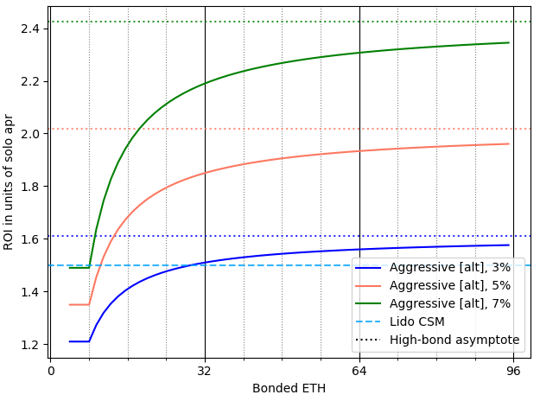
Bond Curves
1.5-ETH bond earns 2.02x more ETH than solo staking
4-ETH bond earns 1.35x more ETH than solo staking
Proposal:
4-ETH bonds for the first 2 minipools
1.5-ETH bonds thereafter
Reasoning:
The initial 4-ETH anchor minipools and node-level penalties allow us to stay safe from MEV theft
The 1.5-ETH bonds serve to keep us safe from slashing
On the right we see the ROI in units of solo APR for this curve based on bonded ETH and a few possible commissions.
Compare 32ETH solo staker vs 32ETH with Rocket Pool
(2 x 4-ETH bonds) + (16 x 1.5-ETH bonds)
Earn 1.85x more ETH than solo staking
Each additional 1.5-ETH bond gets you closer to 2.02x
Sources: appendix

Slide 16
The Toolbox

Slide 17
Core: bond curves and RPL value capture
We discussed these two tools in the previous section.
Bond curves (and node-level penalties) unlock much greater capital efficiency while retaining safety.
RPL value capture is achieved via voter revenue share and RPL buy+burn. This enables removing the current mechanisms at will (RPL threshold for minipool creation; RPL threshold for RPL rewards).
Sources: https://eips.ethereum.org/EIPS/eip-7002, https://eips.ethereum.org/EIPS/eip-7600

Slide 18
Required: EL Triggerable Exits
Currently
A validator exit can only be triggered by the validator key
The Ethereum withdrawal address is the ultimate owner of the ETH, but cannot trigger an exit
RP doesn’t have access to validator keys, so we as a protocol cannot exit validators
With EL triggerable exits
Ethereum withdrawal address can trigger an exit
RP as a protocol would be able to exit validators
Required for this idea:
For safety against MEV theft, we need the ability to exit validators to use the NO’s ETH bond. Validators should be exited to a level where debt is repaid.
For safety against abandonment, exit if validator balances fall below a threshold
Could also be used other ways, eg to allow users to exit their validators on request from RP withdrawal address
Sources: https://eips.ethereum.org/EIPS/eip-7002, https://eips.ethereum.org/EIPS/eip-7600

Slide 19
Required: Universal variable commission
Currently
“Turning the ship” on commission is very hard
NOs must opt in to minipool delegate upgrades
There is no other way to change commission
In practice, we can only execute NO-benefitting change
Can increase commission
Can decrease commission IFF rolling out other changes that are attractive enough to offset that negative component
“Tragedy of the commons”: even if all agree that it would be better for RP to lower NO commission, doing it individually makes it ~impossible
Even in NO-benefitting cases, change is slow
NOs need to actively upgrade
With UVC
Have a protocol-wide Universal Commission
Allows us to make decisions at the protocol level vs convincing individual NOs to participate
Can “turn the ship” rapidly
Avoids the “tragedy of the commons”
This could (optionally) allow us to build self-balancing systems where market dynamics control settings more directly

Slide 20
Required: Megapools
Currently
Each minipool has its own contract
Gas-intense to launch many
CL rewards must be distributed per minipool
Gas-intense to operate many
EL rewards are aggregated across a node
Fee distributor: aggregates rewards
Smoothing pool: Aggregates rewards from many people and then splits them back up periodically, weighted by size and attestations
With Megapools
One contract can support many minipools
Much more gas-efficient to launch and to operate
CL rewards will use similar math to EL rewards to split at the node level instead of the minipool level
This is critical as we move to lower ETH bonds. Imagine a user with 80 ETH. Right now, they make 10 8-ETH minipools. With the suggested bond curve, they’d make 2 4-ETH minipools and 48 1.5-ETH minipools.
Gas costs would be 5x greater than today.
With megapools, they’ll be 10x smaller than today.
That’s a whopping 50x difference!
💪💪💪
Sources: https://github.com/rocket-pool/rocketpool-research/blob/master/Megapools/megapools.md

Slide 21
More tools
rETH protection
“Outlier bad” NOs pay rETH back for their underperformance
UVC: Heuristic/algorithmic processes for balancing revenue splits
Anything from a high level framework, to multiple on-chain PID controllers
Inflation and RPL rewards
Remove the NO share?
At size, could remove inflation and fund pDAO/oDAO with ETH revenue?
Distribute RPL to all NOs based on borrowed ETH?
Ethos/brand
Removing opt-in upgrades
MEV penalty improvements
NO queue details
…
Sources: https://github.com/Valdorff/rp-thoughts/blob/main/2024_02_strategy/readme_tier2.md, https://github.com/Valdorff/rp-thoughts/blob/main/2024_02_strategy/readme_tier3.md

Slide 22
Q&A

Slide 23
Appendix:
Additional slides and resources

Slide 24
Quick links
Overall proposal https://github.com/Valdorff/rp-thoughts/tree/main/2024_02_strategy
Greater RP context https://github.com/orangesamus/RocketPoolRapidResearchIncubator/blob/main/RocketPoolRoadmap.md
Rapid Research Incubator
Results: https://dao.rocketpool.net/t/rapid-research-incubation-begins/2654/4
Short summary per idea: https://dao.rocketpool.net/t/rapid-research-idea-summary/2675

Slide 25
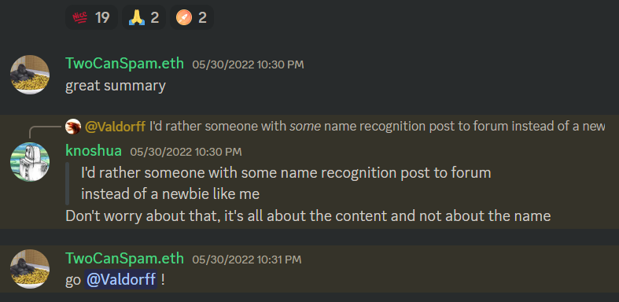
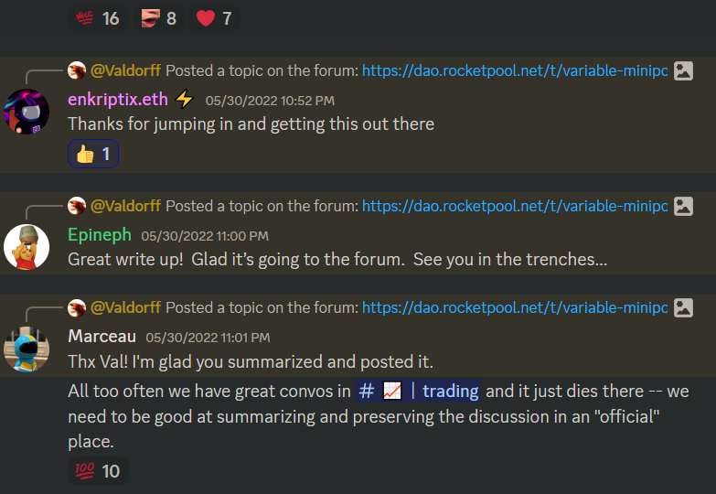
Anyone can contribute - pt 1
Val joined up in April 2022
First contribution was a month and a half later
It was simply summarizing a rambling chat from #trading into bullets, and then posting it on forum

Slide 26
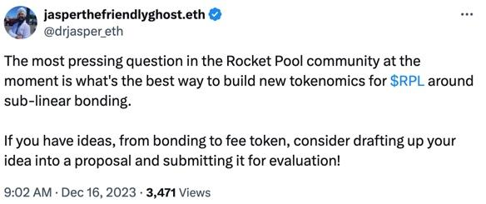
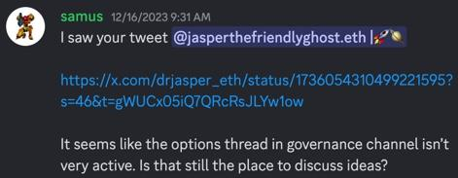
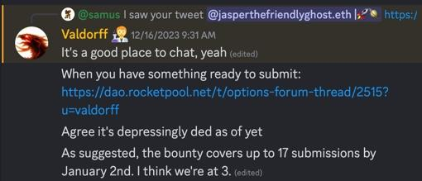
Anyone can contribute - pt 2
Samus joined July 2022, first major contribution December 2023
2nd place! :)

Slide 27
Anyone can contribute - pt 3
Some easy entries:
Review vote text (will be requested in #governance)
Review RPIPs (will be requested in #governance and forum)
Volunteer to post an announcement in #trading across time zones (when you see, eg, Val doing it)
Formulate and write up opinions in a “GMC Community Discussion” thread (monthly)
Bounties (https://longforwisdom.github.io/rp-bounty/)
Summarize long forum threads for #trading
Ask for feedback from #trading on dormant-but-important forum threads
S’more entries:
Dune work (talk to Val or DrWorm)
Run for a GMC seat
Run for an IMC seat
Write initial draft text for something you’ve been following along on (RPIP or vote text)
Even if not used as is, it’s always easier to have a concrete starting point
Volunteer to be an RPIP editor (talk to Val)
Talk to protocols you think would work well with Rocket Pool and write a summary

Slide 28
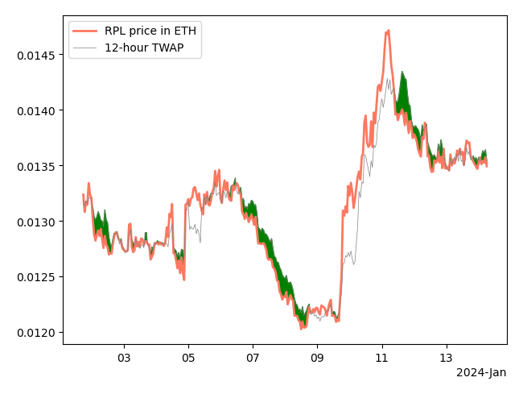
Potential burn design - pt 1
A share of ETH from commission goes to a smart contract
Any user may call a function to swap RPL for the ETH in the above contract
Swap price is based on on-chain oracle (eg, 12-hour Uniswap v3 oracle)
Any RPL swapped is burned by sending it to 0x000000000000000000000000000000000000dEaD
The plot on the right shows market price, TWAP price, and (green shading) when it would be beneficial to burn RPL for available ETH rather than market selling it.
Sources: https://github.com/Valdorff/rp-thoughts/blob/main/2024_02_strategy/readme_tier2.md#rpl-buyburn-thoughts

Slide 29
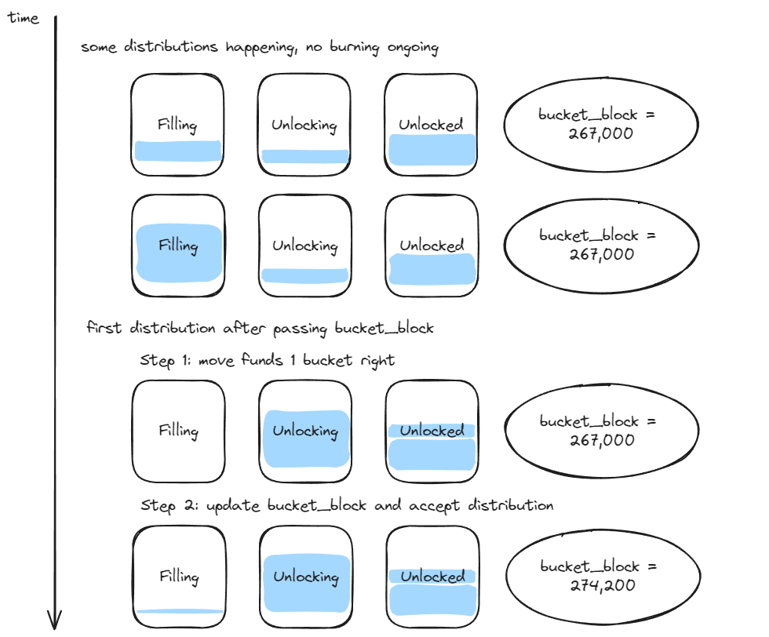
Potential burn design - pt 2
A reasonable concern was brought up around gaming. For example, MEV bots could compete for the smoothing pool distribution. As another example, a large staker could distribute when they know they will be able to bundle it with an immediate RPL burn for a profit.
To mitigate such games, this design prevents any large discontinuous jumps in value available for burns.
The buckets are nominally one day wide
The contract will have Unlocked + Unlocking + Filling ETH in it
The contract will allow burning RPL against Unlocked + (Unlocking*UnlockingRatio)
UnlockingRatio = 1 - ((bucket_block - current_block)/blocks_in_one_day)
Sources: https://github.com/Valdorff/rp-thoughts/blob/main/2024_02_strategy/readme_tier2.md#rpl-buyburn-thoughts

Slide 30
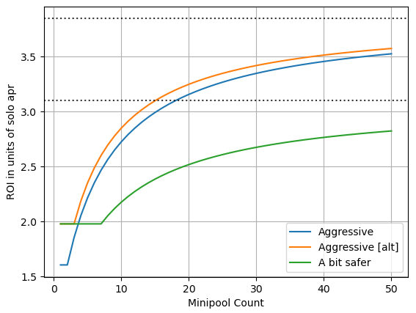
Bond curve comparison
Aggressive: first minipool has a 6-ETH bond, minipools thereafter have 1.5-ETH bonds
Aggressive [alt]: first two minipools have a 4-ETH bond, minipools thereafter have 1.5-ETH bonds
A bit safer: first six minipools have a 4-ETH bond, minipools thereafter have 2-ETH bonds
Val suggested going with “Aggressive [alt]”. It allows some small set of extra hobbyist participants via the lower initial bond, and it eeks out more capital efficiency. There is modest extra risk taken from MEV theft, but the ROI for a significant operator is better if they simply stake honestly with more minipools (which mitigates the MEV theft risk via node-level penalties).
Sources: https://github.com/Valdorff/rp-thoughts/blob/main/2023_11_rapid_research_incubator/bond_curves.md

Slide 31
Val’s guide to UVC in practice
We have a total revenue stream to split up
rETH
Node operation
Voting
RPL buy+burn
NOs first: Consider node operation a cost. We need to pay enough for it to attract enough NOs to meet rETH demand. This is likely to be primarily dependent on the NO marketplace (eg, Lido CSM and other competitors). While growing, set generously. At maturity, set as low as possible without this being a bottleneck at all.
Voters second: We need “enough” RPL voting. I propose increasing the slice if <40% of RPL can vote, decreasing it if >85% can vote, and otherwise leaving the slice alone.
RPL last: RPL should now try to maximize the size of its slice. RPL value is proportional to both RPL’s revenue split and rETH TVL, so rETH’s interests are represented here. Note that it’s possible that there’s a better way to grow rETH than simply lowering commission (eg, incentives to use a partner protocol).
Sources: https://github.com/Valdorff/rp-thoughts/blob/main/2024_02_strategy/readme_tier2.md#dynamics

Slide 32
RPL voter rewards
The current proposal favored simplicity – a node’s weight is simply their staked RPL, capped at 150% of the value of their bonded ETH. But there’s other options…
Scale by vote power
This is really intuitive, but it encourages sock puppet accounts
Could model this impact vs the anti-sock puppet impact of the bond curve
Could scale between linear-to-150% and quadratic-to-150%. This could look like a smaller cap, a piecewise definition, etc.
Could base it off of active governance instead of the latent potential for governance
This should definitely count delegation
This topic is worth more time and discussion within the community, and maybe some modeling.
Sources: https://github.com/Valdorff/rp-thoughts/blob/main/2024_02_strategy/readme_tier2.md#dynamics

Slide 33
This proposal ✖ RPL inflation
We suggest ending RPL rewards and their associated inflation (3.5% of the 5% total)
If we are (a) attracting enough NOs and (b) getting “most” RPL staked, RPL inflation for NO rewards becomes a little silly
RPL is debased, and then the same holders are rewarded based off the debasement
We propose putting in settings, currently set to 0%, for pDAO and oDAO shares of revenue
While we don’t currently receive enough ETH to operate from that directly, this is quite possible if we significantly grow
Might as well have the settings, so we could turn those on and remove RPL inflation entirely based off of a vote, with no need for SC changes
Sources: https://github.com/Valdorff/rp-thoughts/blob/main/2024_02_strategy/readme_tier3.md

Slide 34
Interim concept: RPL loans
Fund a multisig with ~10k RPL for the first iteration of this program, which is enough for around ~500 LEB8s
Use MYSO to take collateral in the form of rETH/ETH BPTs (balancer liquidity tokens)
2.5 ETH worth of RPL for 1 year; 80% LTV; up-front fee of 10% which is refundable if used "properly"
The assumption is that by the end of the loan term, ETH-only would be an option, so the user could freely repay their RPL and continue participating if that's their preference. If we'd like to do 1.5 years for increased user confidence, that would be fine too.
This means a user would:
post 3.26 ETH worth of rETH/ETH BPT using their node or withdrawal address
3.01 are locked as collateral
0.25 are given to the multisig
After a year, the 0.25 ETH fee is sent back to them if the node in question
(a) staked the RPL within a week of the loan
(b) started an 8-ETH minipool within two weeks of the loan, and
(c) kept bonded ETH at the level of (b) or higher for the year
Sources: https://github.com/Valdorff/rp-thoughts/blob/main/2024_02_strategy/readme_tier2.md#stepping-stones

Slide 35
Interim concept: remove RPL requirement
This could only be done after a successful vote to new tokenomics
The premise is that assets forward price -- so if we have a new value capture mechanism, it should immediately be relevant, even before implementation.
If that's the case, we're free to remove the RPL requirement. (If a zero adds complexity, this can be arbitrarily small -- eg 0.1% of borrowed ETH instead of 10%)
Val thinks this is theoretically sound
Val is not confident it’s a good idea
It’s unclear what RPL rewards should do in such a case. Val’s first instinct is to keep the 10% borrowed cliff. That said, NOs could exit and remake them without RPL on another node to get RPL rewards on their initial node. 🤔
Sources: https://github.com/Valdorff/rp-thoughts/blob/main/2024_02_strategy/readme_tier2.md#stepping-stones

Slide 36
OpenUX results
Dropoff onboarding process: Tokenomic & risk concerns: Chooses another option due to tokenomic and/or security concerns, smart contract risk, dissuaded by feedback from others, complex financial modeling.
How might we simplify and demystify the concept of tokenomics for users to alleviate misunderstandings and hesitations?
RP node vs. solo staking: (negative: Forced RPL exposure), RP node vs. holding LST (negative: Forced RPL exposure)
Node operators with more ETH bonded have greater concerns around tokenomics. The required exposure to RPL makes many potential users feel hesitant about becoming a node operator. While the token is volatile, it also comes with a high yield for RP node operators. Therefore it’s important to nuance the understanding of RPL through making sure the upside is clearly communicated.
Those with less ETH bonded are likely to attain fewer financial benefits from staking than those with more. Therefore it’s vital that Rocket Pool promotes the ‘softer’ reasons to be a node operator (community, exploring and learning about crypto, and helping to keep Ethereum decentralized). If Rocket Pool fails to communicate the softer benefits then people might rely solely on a rationalistic cost/benefit analysis. In that case alternatives with less effort, upfront investment and responsibilities will seem attractive in comparison.
Sources: https://dao.rocketpool.net/t/completion-of-user-research-report-how-node-operator-experience-insights-can-help-rocket-pool-continue-to-enhance-the-security-of-ethereum/2615

Slide 37
Vitalik: “What’s stopping you from solo staking?”
Results:
Part 1:
1541 Votes: “Want liquidity / other yield / have <32 ETH”
1191 Votes: “Running validator node too hard”
264 Votes: “Concerns about private key risk”
Part 2:
2372 Votes: “Have < 32 ETH”
255 Votes: “Can’t take ETH out instantly”
191 Votes: “Want other defi yield”
Conclusion:
🛑 The top two barriers to solo staking are having 32 ETH for it and perceived difficulty
💪 RP offers a lower entry point, provides easier UX, and has a strong community to support stakers
🧡 RP creates an opportunity for more home stakers to contribute to the health of the Ethereum
Sources: https://fc-polls.vercel.app/polls/5dbd0c32-ec33-43bb-88ef-aff8ccd14063
https://fc-polls.vercel.app/polls/0dc157e8-9258-4ead-91d2-fe0eb4059190

